Slide 1

unit 8 Assignment 2
Design, Develop, Test and Review and Interactive App

Slide 2
purpose and user requirements for my app
It needs to be simple and easy to understand for its audience considering it is aimed at younger children learning the alphabet.
It needs to teach the alphabet and be interactive to keep the audience engaged.
The audience for my app is going to be younger aged children who are learning the alphabet, probably from 3 to 9 years of age. People with access to mobile devices and the Internet.
The buttons needs to be large enough to be easy to see and click because children will find it difficult to press the buttons, this will make it easier for children to navigate.
The screen needs to be exciting and easy to look at. The layout needs to be easy to understand and exciting with good colors but not cluttered to keep retention.
The app needs to play sounds with good volume and audio quality.
All of this needs to be done with the audience in mind the younger children who we'll find it harder to navigate and press buttons because the fingers normally have low dexterity, and they normally look for bright colors so highlighting important information and buttons will help to improve the user experience.

Slide 3
My proposed solution for this app
My proposal is to have a range of different lessons including interactive lessons with increasing difficulty to help teach the children the basics of the alphabet and how to remember it.
Here is my rough design for a navigation chart.
Home page
All lessons laid out
Lesson 1
Lesson 2
Lesson 3
Lesson 4
Lesson 5
Lesson 6
Lesson 7
Lesson 8
Lesson 9
Lesson 9

Slide 4
Asset table
asset​​ | URL​​ | description | Suitability
​​ tutorial | Link | Video tutorial on how to play sounds on an app | This tutorial is suitable for the creation of my app because it helps me play sounds on the app when buttons are pressed.
​​ tutorial | Link | code snippets pre-defined programs | This is suitable for the creation of my app because it helps me use code snippets and pre-defined programs to build my app to the requirements.
​​ | NA​​ | Alphabet sounds | This is suitable because it plays all the sounds in the alphabet and can help correlate between the shape and sound of a letter making it easier for children to learn the alphabet.
​​

Slide 5
my pseudocode and concept ideas.
Home page
Description and header with a button which went clicked links to all lessons.
All lessons
Top header it and description with a grid of buttons linking to each lesson when clicked.
Lessons p1
Interactive buttons which when clicked play a sound of the letter displayed, to teach the letters.
Lessons p2
Test to see if they know the letters by having a button that plays a sound of a letter when clicked and a range of buttons of letters on them which display colors red or green went the wrong or right answer is selected, then a button at the bottom to link back to the lessons.

Slide 6
My layout ideas
Here are my rough layout ideas for the official design of my app.
I choose to use a nice green color for the buttons because it looks very cheerful and gives a positive view of the app an alphabet to the audience younger children.
Data inputs and outputs
the app will require the input from the touch screen from the user and will output sounds played through the app when buttons ah pressed, to correlate the sounds and letters to each other.
Home
All lessons
Text
Text
Home
Lesson 1
Lesson 5
Lesson 2
Lesson 6
Lessons
Lesson 3
Lesson 7
Lesson 4
Lesson 8
Lesson 1 part 1
Lesson 1 part 2
Text
Text
Letter sound
a
b
c
d
e
f
g
h
i
j
k
l
b
k
a
f
Next
Select

Slide 7


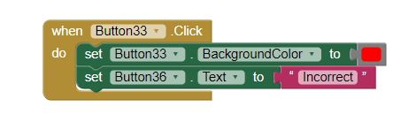
pre-defined programs/code snippets
For the creation of this app, I will be using MIT app inventor, it is a drag and drop program, this will make it easier to create the app.
MIT comes with many prebuilt functions and operations which were useful in the creation of this app, some of which include the when click and open another screen, and more, I have images of function on this side.

Slide 8
Lesson 1
Alternate designs
My alternate design are to have all the lessons in one long sequence without any other pages, this is all simpler and easy to understand although doesn't offer much of an explanation or way of choosing which lesson you'd like to start on or go back to which could be very inconvenient and confusing.
This alternate design although it could be great it's a lot more confusing than my other design which lasts for much easier navigation and it's easier to understand for the audience.
This design is much harder to use and navigate because you'd have to navigate through each site every time to get where you are up to which could be very annoying.
Lesson 1
a
b
c
d
e
f
Lesson 2
g
h
i
j
k
l
Lesson 3
Next
Lesson 4
Lesson 2
a
b
c
d
e
f
Lesson 5
g
h
i
j
k
l
Next
Lesson 6

Slide 9
Justification
the reason I chose the navigation and design that I laid out above is because it is simple and easy to navigate and displays every lesson out so you can choose which one you want to start on or go to if you were already part way through.
I chose to have a very basic interface with as little buttons as possible with very simple processes, so it is easier for the audience younger children to understand and use.
The reason I chose to have a home screen is so I can introduce the app to the audience and so they get an idea of what the rest of the app is before they get straight into the lessons.
the reason I chose all these design choices is because it is it easier for the audience to use the site and understand what to do and learn the alphabet.
Some of the constraints I had with creating the have all the changes of screen sizes across devices and creating a compatible program across all screen sizes.

Slide 10
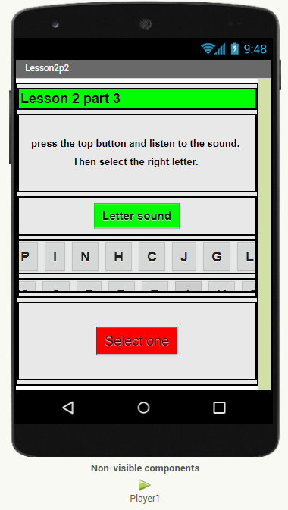
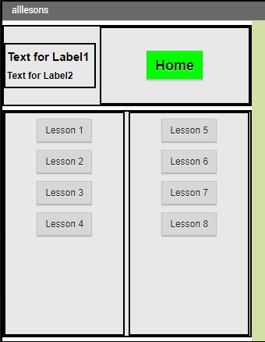
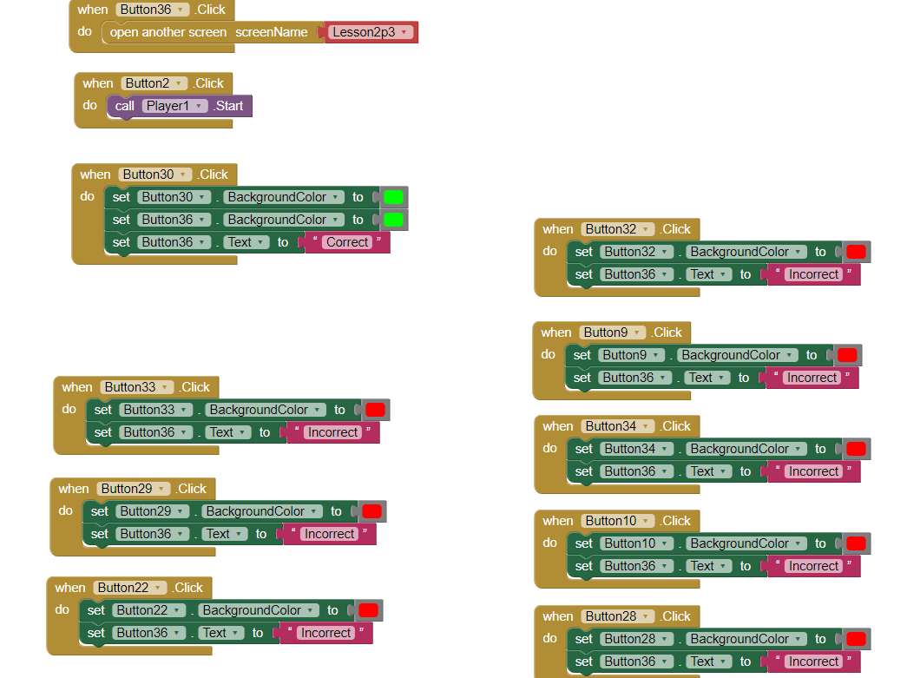
How I developed the app
For the creation of this app, I use MIT app inventor, it uses drag and drop programming, so it made it much easier to right yeah unfold in my designs.
I was able to add players into the app to play the sounds of the letters indie block code I was able to code it so when the buttons were clicked it would play the sound of the letter that the button is displaying.
with the code I was able to add more interaction by changing the color of the buttons when they were clicked to display weather you got the right answer or not.

Slide 11
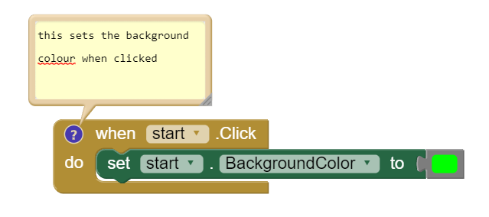
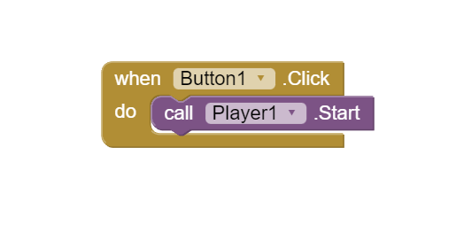
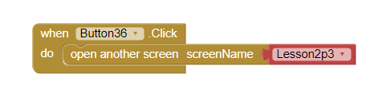
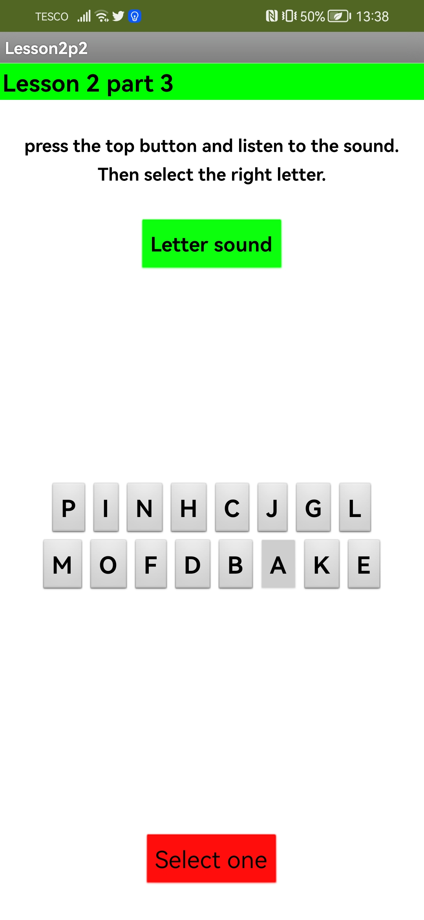
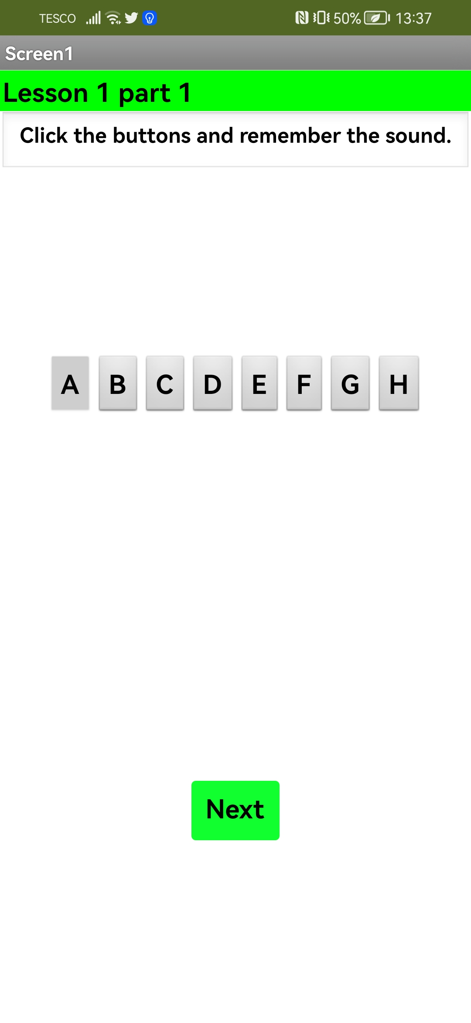
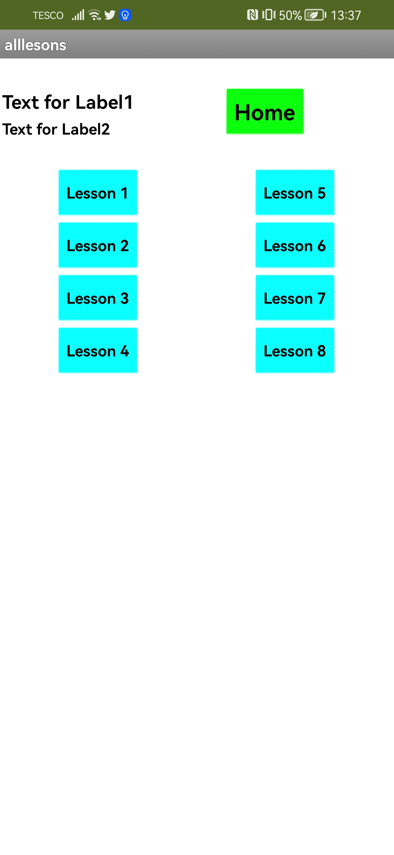
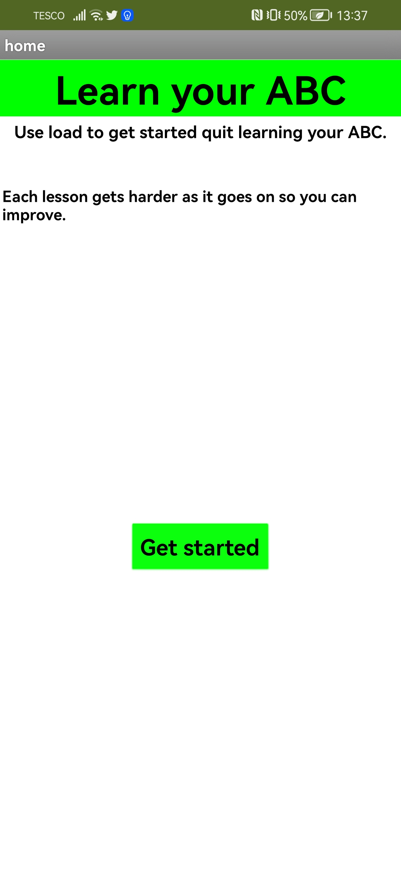
pre-defined programs/code snippets
This code helps me change the colour of a button when pressed to show whether you get the right answer or not.
This code is used to play sounds of the alphabet on my app when a button is pressed.
this piece of code opens a different screen when clicked which I used together with the other functions to create an easier app to navigate.
I was able to use these code snippets to add interaction on the buttons like changing the background color and playing a letter of the alphabet. This increase user experience considerably and can create a much funnier time on the app.
screenshots of application
These screenshots show the app and how it is suitable, like the bright colours and clear labelling that helps with interaction.
I made sure to add the correct sounds to the correct button and I make sure that I labeled the buttons correctly, so navigation is easy to understand and use with color coding used in certain situations for more intuitive use.

Slide 12
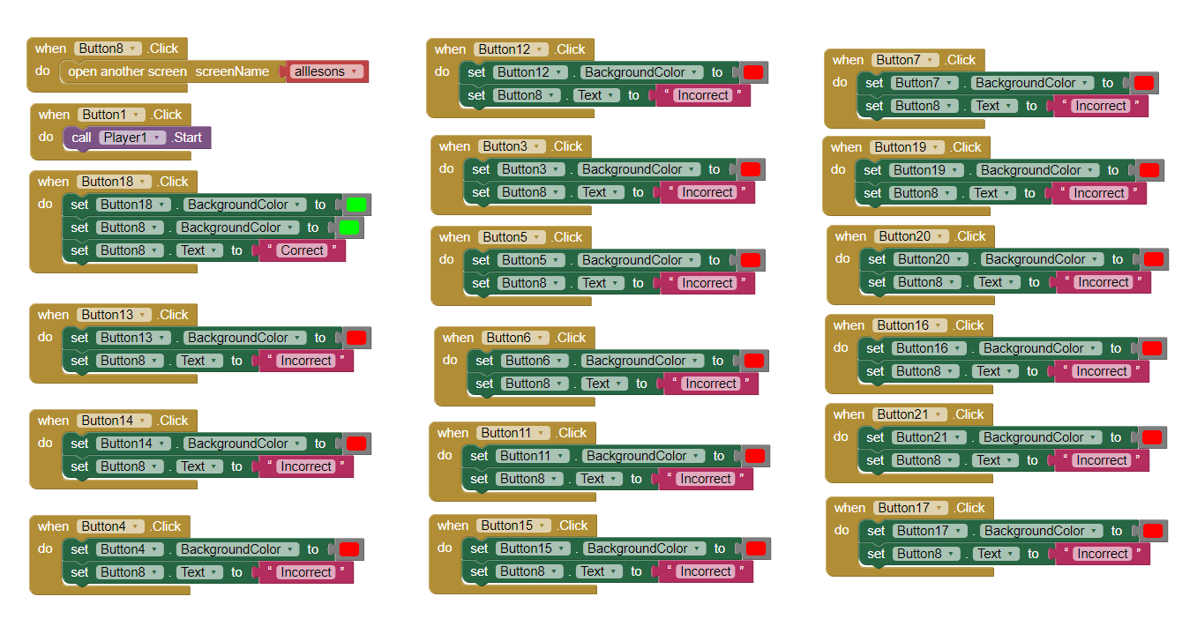
Here I used this function to move to the next screen went clicked
Here I changed the bottom buttons color when the correct answer is selected, as well as the text to say that you selected the correct answer which is used to show the user when they have choosing the correct answer.
Most of these blocks of code we'll display the red color on the button when you select the incorrect letter and changing the text on the bottom button to incorrect.
I used this function to play a player which I had uploaded a sound of a letter from the alphabet to.
I use this function to change the color and text of the bottom when the incorrect answer is selected.

Slide 13
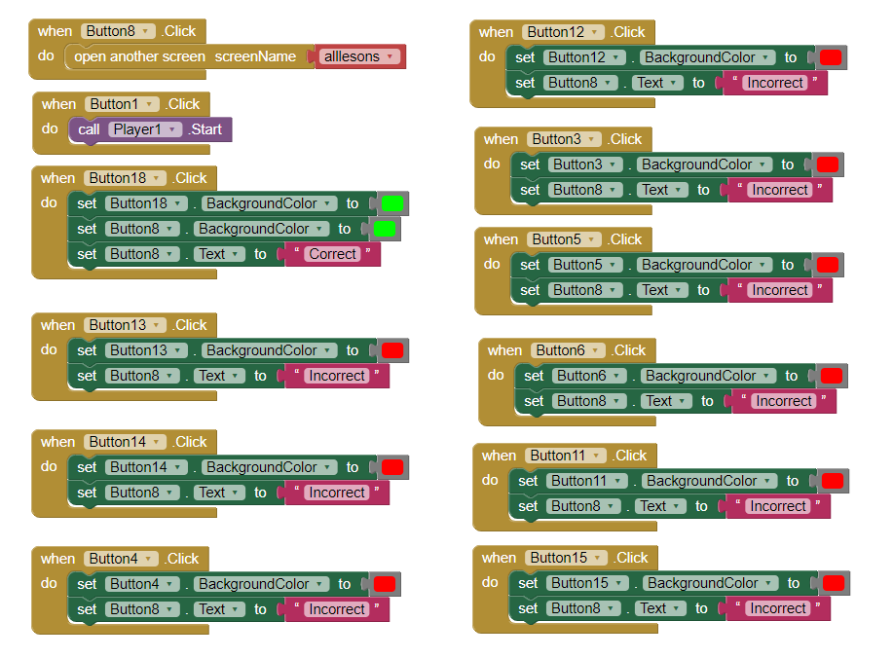
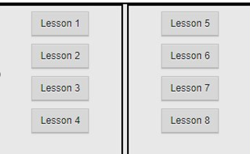
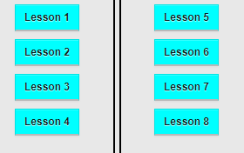

Quality of my code
I made sure to structure it in a simple why and due to its drag and drop structure it is very easy to understand.
The code is drag and drop so it is easy to change and understand because it states the function on the block so it is easier to grasp what it does, so it would be easy for another person to work on the code with very little training.
Changes based off user feedback
Some of the changes I'm going to make based off my feedback are to change the colors of the buttons for each lesson, I got feedback that they look quite bland with a plain Gray color, so I changed the front and background color to look more outstanding.
Integration with my portfolio
I can download a copy of my app from the MIT app inventor so I can integrate it into My Portfolio in my unit assignments.
I had to select the right file type to keep it compatible with My Portfolio.

Slide 14
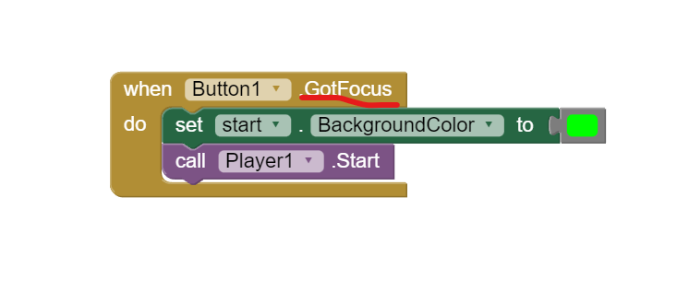
My test plan
Number​ | Item to test​ | How to test​ | Expected outcome​ | Actual outcome​
1​ | navigation | Check to see if it is navigating correctly and links between sites are working and check with other people to make sure it makes sense. | I would expect the navigation to work correctly and be easy to understand. | ​my app is very easy to navigate and understand.
2 | sounds playing properly | Press the buttons which play the sounds and listen to it if they play the correct sound. | I would expect all the buttons to come play the correct sound although some could be mixed up, but it would be a quick fix. | All these sounds play properly, and all the sounds play correct for each letter
3 | Check size for different screens | Check me up on different devices and screen sizes to check if it displays correctly. | I'd expect it to display differently across devices but should work correctly. | The size works perfectly on most phones although I haven't tested it on some smaller devices.
4 | Simply and adequately teach the alphabet | Testing out to make sure it is teaching the alphabet adequately and show two younger children to make sure they understand it and find it relevant. | based off the amount of work I've put into it I would expect it to be easy to understand and simple to use. | it is very simple and it's good at teaching the alphabet for younger children.
5 | Functions are working and displaying correctly | test make sure buttons change color correctly when clicked and link to the correct slides. | I would expect it all to work perfectly | some of the buttons did not work properly and would not display the right colors or link to the right screens.
Fixes
There was a bug in the code where the button was not doing what it should because I had set the button to
(when Button 1 Got Focus) so it would not display the right color when clicked.

Slide 15
My review of the app
Overall, I'm happy with my app although I could add more user interaction into the app with possible login so it can save your progress, but this is a lot more complicated considering the audience would be younger children who wouldn't be able to understand how to use all that kind of stuff.
I'm happy with the background imagery and they're simple but cheerful colours help to keep the user engaged because younger children like bright colors it will help them get a better experience while learning the alphabet.
I am happy with my code considering it is very simple and easy to understand with no bugs because it is so simple considering it doesn't need to do anything complicated but play sounds and link between pages, I think this is perfect because younger children do not need a complicated app but just something that can help correlate these sounds and letters to each other.
I can also add a different branch of the site for older children in the future to teach more complicated concepts related to languages or reading and writing in general, because I you a home page I could change that so it links not only to lessons teaching the alphabet, but also lessons teaching how to then read or write as well as other languages so it has the capabilities of expansion and to be turned into a more powerful app in the future.
My final app is suitable for the target audience of young children because I used fairly bright colors and made each button large enough so they can easily see them, and the navigation is simple for them to use so they do not need to be trained by an adult.
The buttons are large enough to be easy to see and click for children. the buttons are easy to identify and press. This makes it easier for children to navigate. The screen could be more exciting and easier to look at. The layout is easy to understand and exciting with good colors but not cluttered. The app play sounds well with good volume and audio quality.
The overall design of the app and structure is fairly simple and does a good job of teaching the audience so I do not see any necessary changes that should be made.

